Slide 1
Having a Coronavirus test with a grown-up helping me.
A Social Story
INSERT PICTURE HERE OF CORONAVIRUS TEST
INSERT PICTURE HERE OF YOUNG PERSON/ GROWN UP

Slide 2
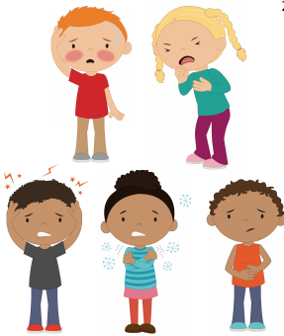
If I need a Coronavirus or Covid-19 test this might be because I or someone I know is poorly.
This might not mean that I have Coronavirus but it is best to have a test just to make sure.
Having a test will help to keep everyone as safe as possible.

Slide 3
There are different places to have the Coronavirus test.
Some people might have a test at home.
Some people might go to a drive-through Coronavirus test centre.
Some people might go to hospital, doctors or clinic.
Some people might go to a different place near their home.
Most tests are the same wherever you go.
I am having my test at ……………………………..
INSERT PICTURE OF HOME HERE
INSERT PICTURE OF TESTING STATION HERE
INSERT PICTURE OF PLACE HERE
INSERT PICTURE OF PLACE HERE

Slide 4
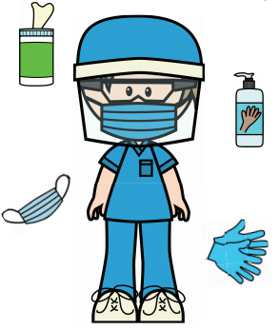
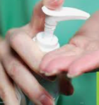
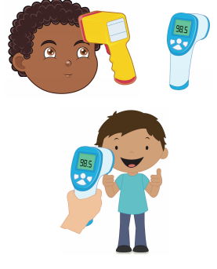
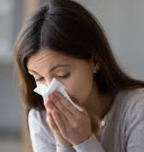
The staff at the testing station will all be wearing special protective equipment. This is ok, it is just to keep them safe.
Firstly, I will probably be asked to wash or sanitise my hands.
If I go to the testing centre they might take my temperature usually with an electronic thermometer that does not touch my skin.
Next, I might be asked to blow my nose into a tissue and throw it away.

Slide 5
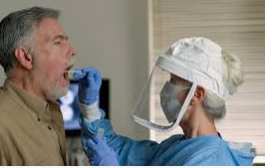
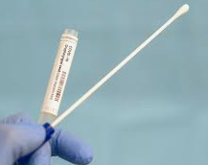
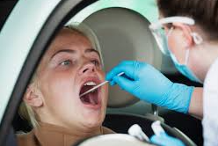
A grown-up will do the test for me.
The first thing that I will have to do is to swab my throat with a special cotton bud called a swab.
I will need to open my mouth wide and say ‘ahhhhh.’ The grown up will put the swab inside my mouth and rub it on my tonsils for 10 seconds.
I can count in my head 1,2,3,4,5,6,7,8,9,10.
This might feel a bit yucky but it will be finished quickly.

Slide 6
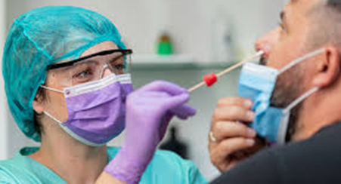
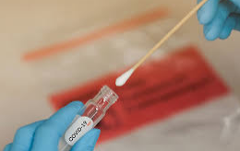

Next, the grown up will need to swab my nose, just one nostril.
They will put the swab inside my nostril and twist it around.
This might tickle a little bit.
Then they will take the swab out of my nose and put it straight into a special tube.
The test has finished now.
I might be asked to wash or sanitise my hands again.

Slide 7
My swab will now be sent away to be checked.
The results might come through on a text or an email.
Sometimes the results are through quickly, in around an hour and sometimes they might take a few days.
A grown-up will tell me how long to expect to wait.
It is important that I stay at home while I wait for the results.
INSERT PICTURE OF HOME HERE

