Slide 1
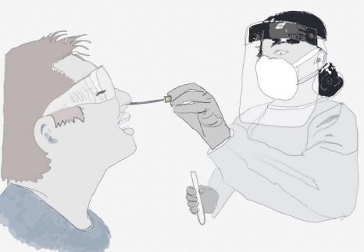
Having a Coronavirus test independently
A Social Story

Slide 2
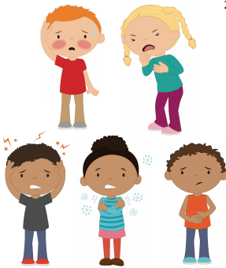
If I need a Coronavirus or Covid-19 test this might be because I or someone I know is poorly.
This might not mean that I have Coronavirus but it is best to have a test just to make sure.
Having a test will help to keep everyone as safe as possible.

Slide 3
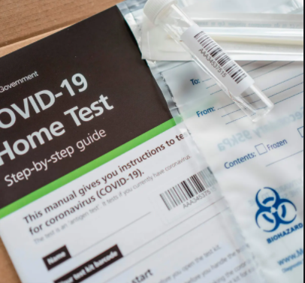
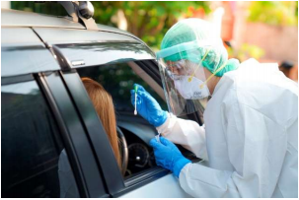
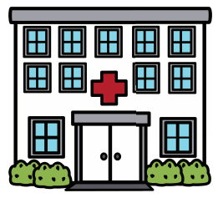
There are different places to have the Coronavirus test.
Some people might have a test at home.
Some people might go to a drive-through Coronavirus test centre.
Some people might go to hospital, doctors or clinic.
Some people might go to a different place near their home.
Most tests are the same wherever you go.

Slide 4
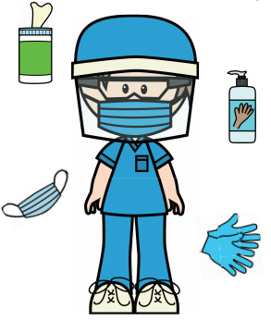
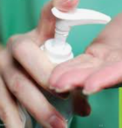
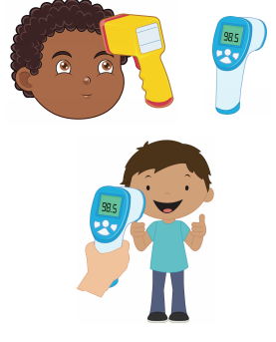
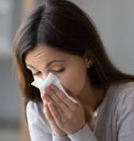
The staff at the testing station will all be wearing special protective equipment. This is ok, it is just to keep them safe.
Firstly, I will probably be asked to wash or sanitise my hands.
If I go to the testing centre they might take my temperature usually with an electronic thermometer that does not touch my skin.
Next, I might be asked to blow my nose into a tissue and throw it away.

Slide 5
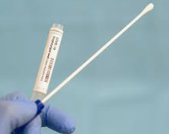
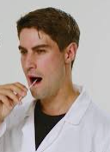
I will do the test myself, the staff will tell me what to do.
The first thing that I will have to do is to swab my throat with a special cotton bud called a swab.
They might give me a mirror to look in to. I will need to open my mouth wide.
I will put the swab inside my mouth and rub it on my tonsils for 10 seconds.
I can count in my head 1,2,3,4,5,6,7,8,9,10.
This might feel a bit yucky but it will be finished quickly.

Slide 6
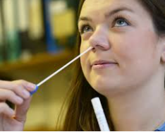
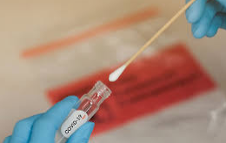

Next, I will need to swab my nose, just one nostril.
I will put the swab inside my nostril and twist it around.
This might tickle a little bit.
Then I will take the swab out of my nose and put it straight into a special tube that the staff will give to me.
The test has finished now.
I might be asked to wash or sanitise my hands again.

Slide 7

My swab will now be sent away to be checked.
The results might come through on a text or an email.
Sometimes the results are through quickly, in around an hour and sometimes they might take a few days.
The staff will tell me how long to expect to wait.
It is important that I stay at home while I wait for the results.

